Slide 1




Talk Rooms
Apresentação de DAW – G6
Tiago Silva - 48252
Gonçalo Ribeiro - 48305
Rosário Machado - 46042
https://github.com/isel-leic-daw/2024-daw-leic53d-g06-53d

Slide 2
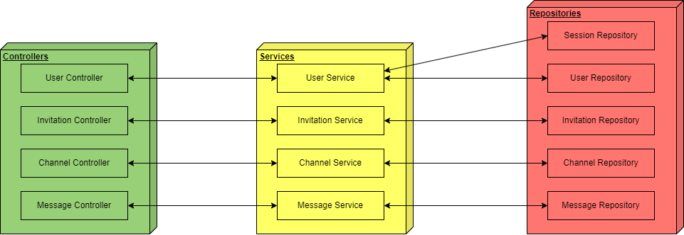
Backend Diagram

Slide 3
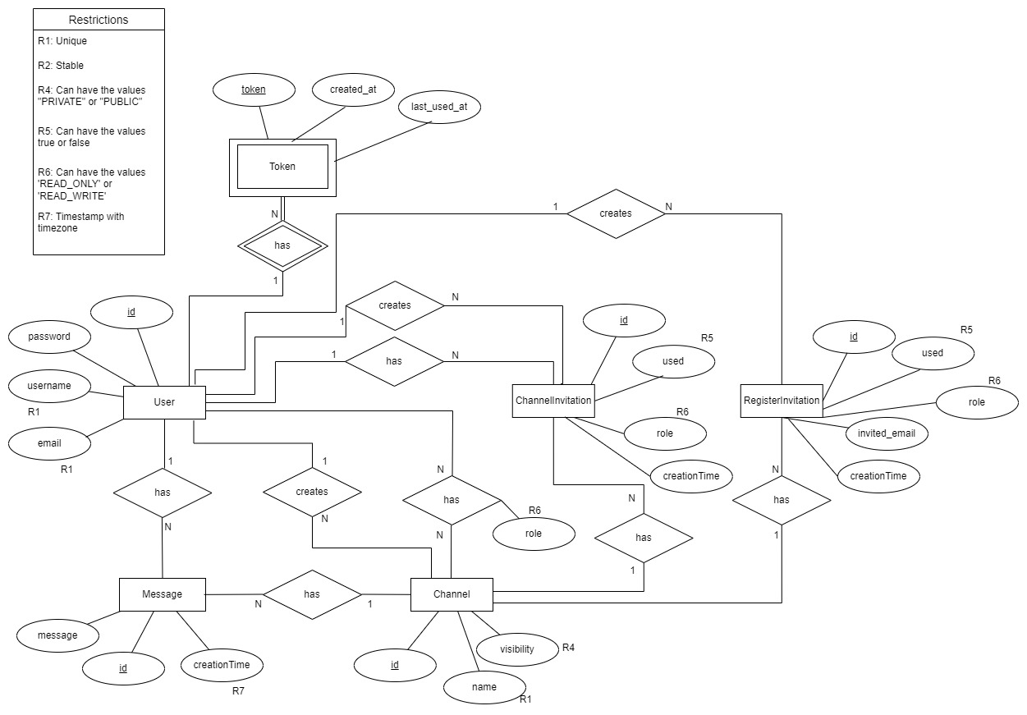
Database Diagram

Slide 4
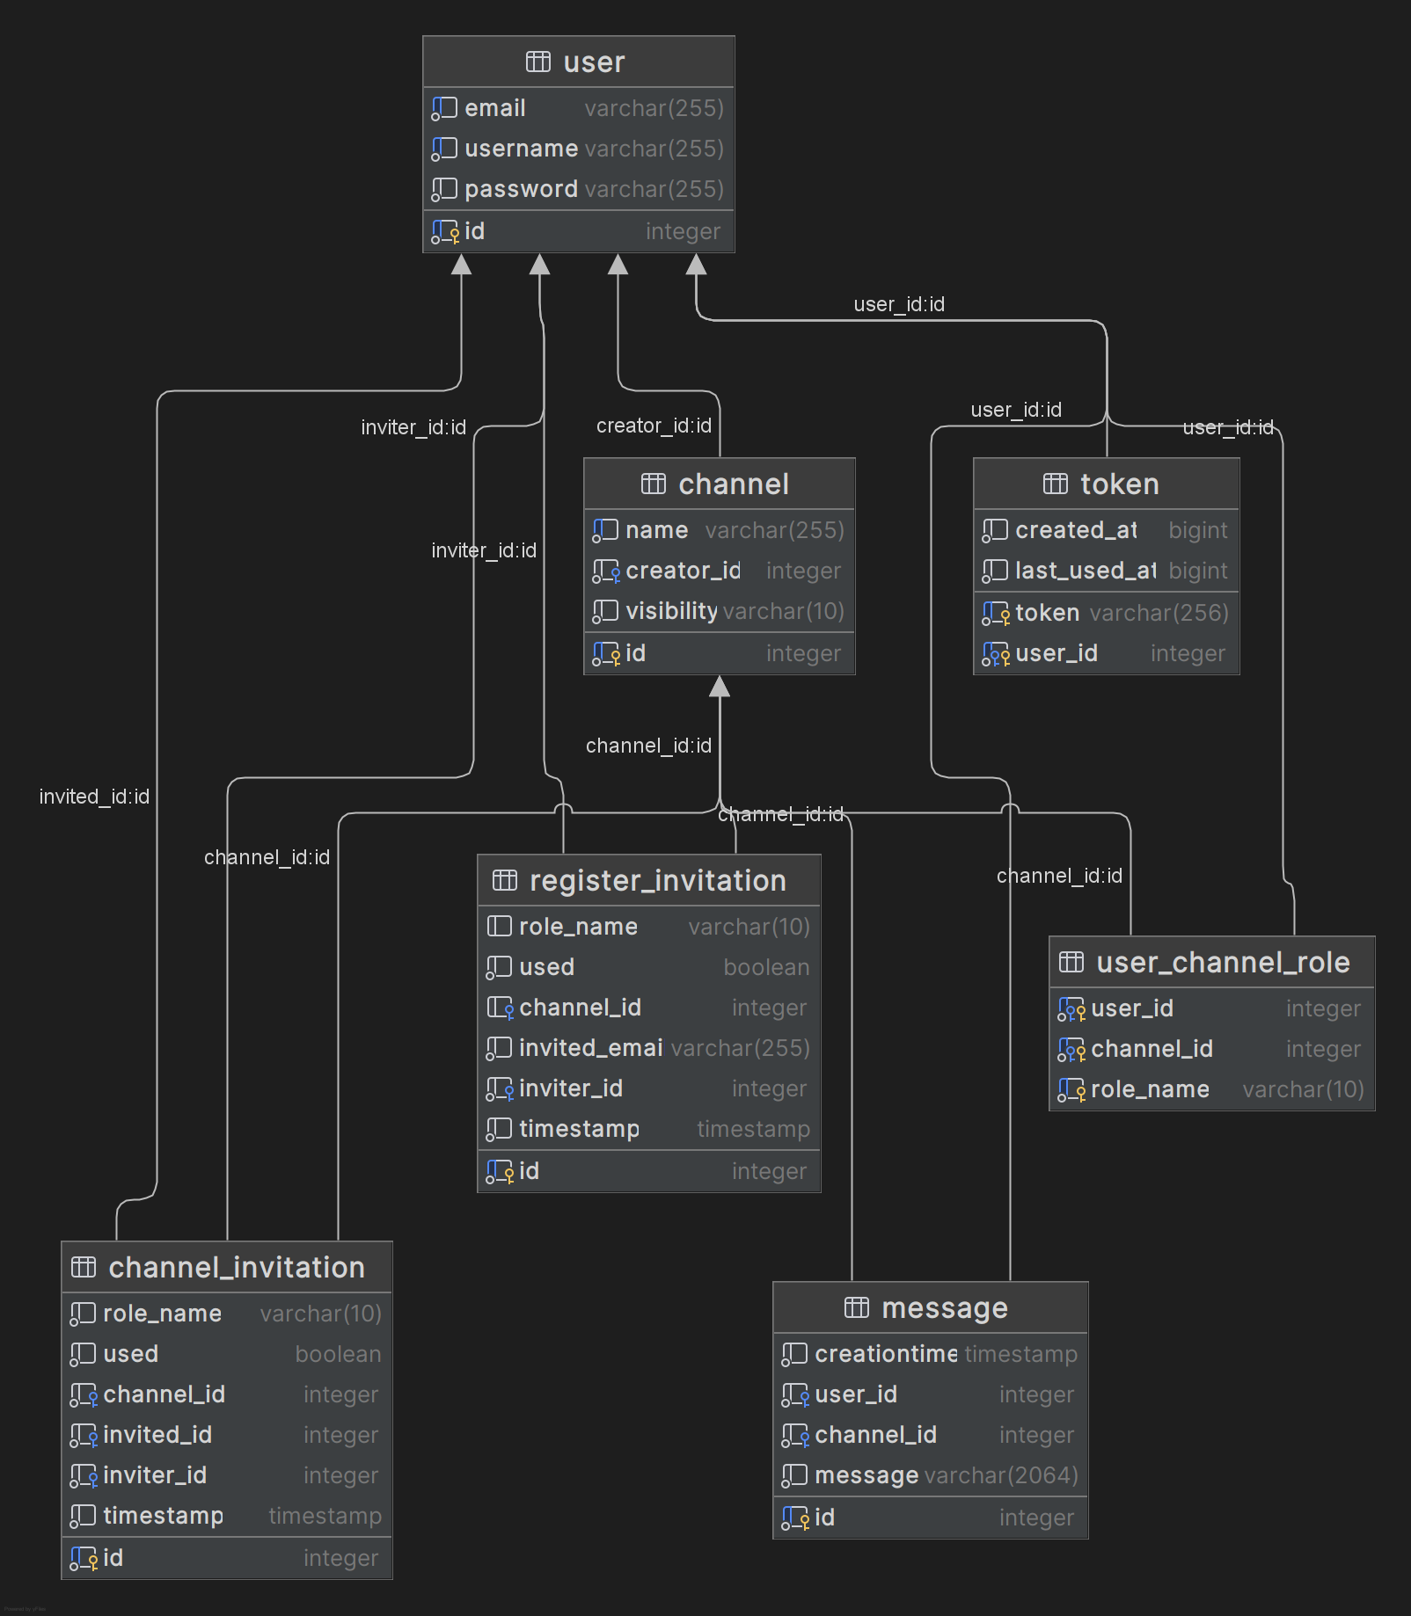

Slide 5
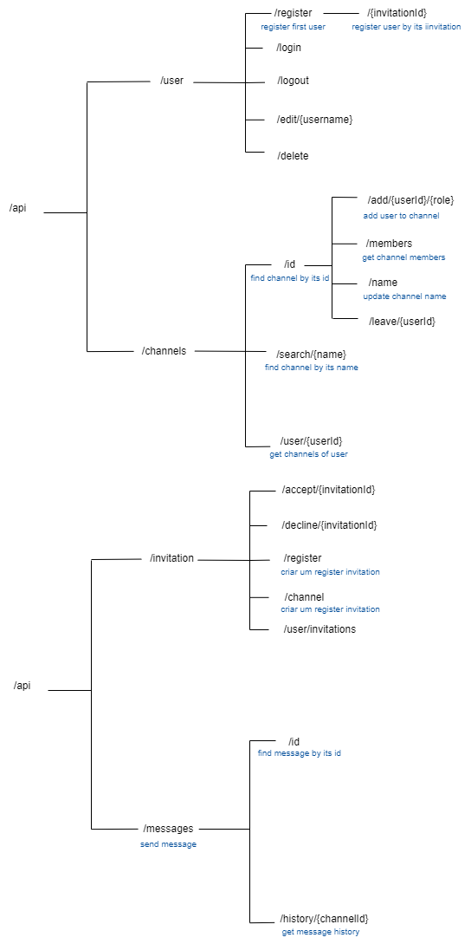
Routes
User and Channels

Slide 6
Routes
Messages and Invitation

Slide 7
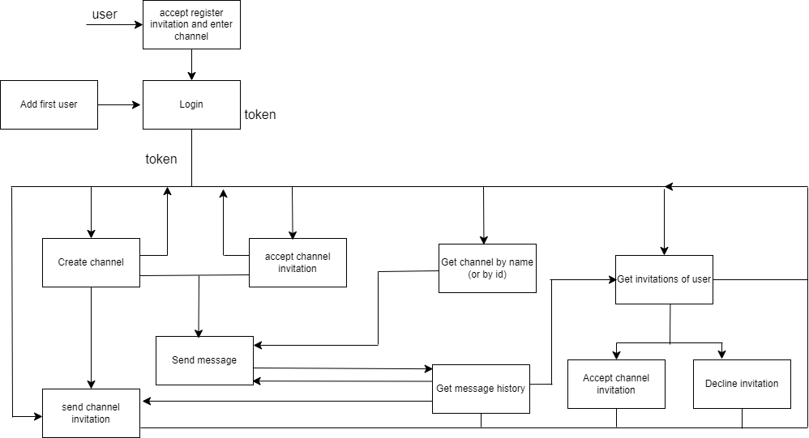
User journey

Slide 8
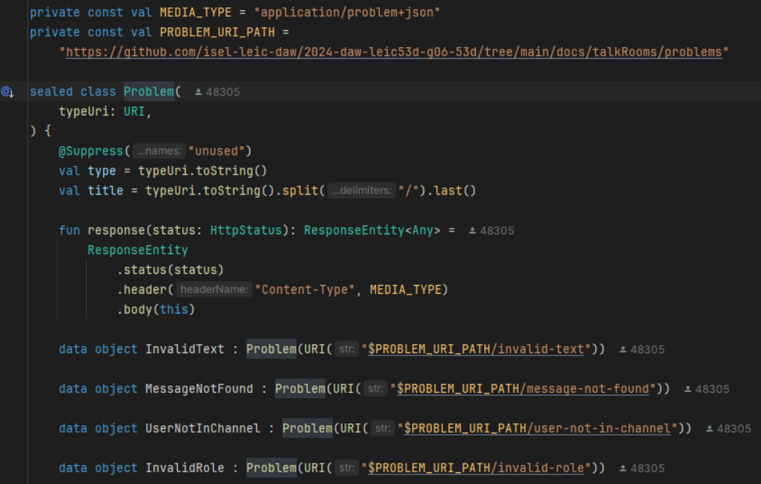
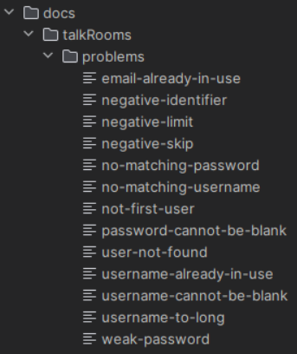
Media
Types
application/problem+json - problem for the API responses in case of errors
application/json - JSON for the API request bodies

